Slide 1

Presentation of end of studies project
Designing and develeping a dynamic web application for the management of fitness activities
Supervised by:
Dr. Ben Ftima Fakher (ISIMM)
Mr. Kais JRAD(Mega-Dev)
Realized by :
Rami Ferjani
2020-2021
Notes:
good morning mr president and members of the jury before we begin i'd like to thank you for agreeing to judge our work, my name is rami Ferjani and it’s my honor to present you my end of studies project which consists of designing and developing a web application for the management of fitness activities developed within th Mega-DEV company

Slide 2






PLAN
1.0
2.0
3.0
4.0
5.0
6.0
Study of the existing and proposed solution
specifications
General context
Conception
Realization
Conclusion
and perspectives
2021
PFE
Notes:
In order to illustrate our work well, we have chosen to follow the following plan:
First of all, we will present the general context of the project
Then I will move on to the study of the existing and proposed solution
Thirdly, we will discurss the specifications
Afterwards, we will present the conception,
Followed by an overview of the realization of our project
And finally , we will finish by taking a look at the conclusion and perspectives

Slide 3
GENERAL CONTEXT
1.0
Notes:
Starting with the General Context

Slide 4
1.0 GENERAL CONTEXT
1.1 Presentation of the
host company
1.2 Motivation
1.3 Problematic
Notes:
Within the general context, we will begin by a presentation of the host company,followed by the motivation and problematic

Slide 5

1.1 Presentation of the host company
1.0 General ContextT
Mega-DEV. is a digital agency based In djerba Houmet-souk.
Services:
Web/mobile development
Software Solutions
Digital Marketing
2021
PFE
Notes:
I passed the internship within the Mega-Dev agency which is based in Djerba Houmet-souk, among its services we mention web/mobile development as well as software Solutions and digital Marketing.

Slide 6
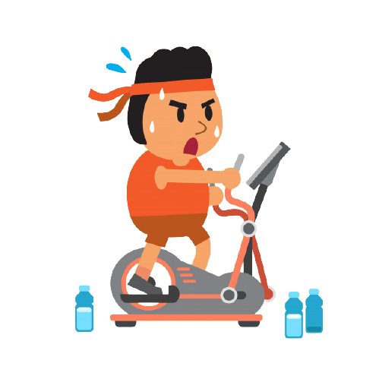
1.2 Motivation
Exercicing is the key to better health and longer life
1.0 GENERAL CONTEXT
2021
PFE
Notes:
Several studies have proven that exercicing has many postif advantages on our health, it improves blood circulation and prevents obesity as well as protect from certain disesaes

Slide 7
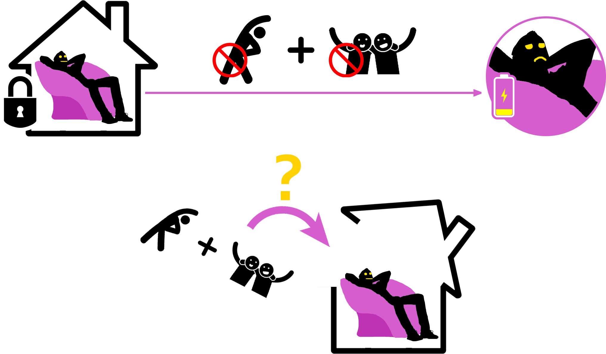
1.3 Problematic
1.0 GENERAL CONTEXT
2021
PFE
Notes:
But in the same time,it can be difficult to figure out what you need to do on your own as well as it’s easy to lose motivation and get discourged especiallt if you’ re working out from home since the comfort of our home doesn’t provid the same motivation the gym enviroment does,such as seeing other people exercicing can give you a boost in motivation

Slide 8
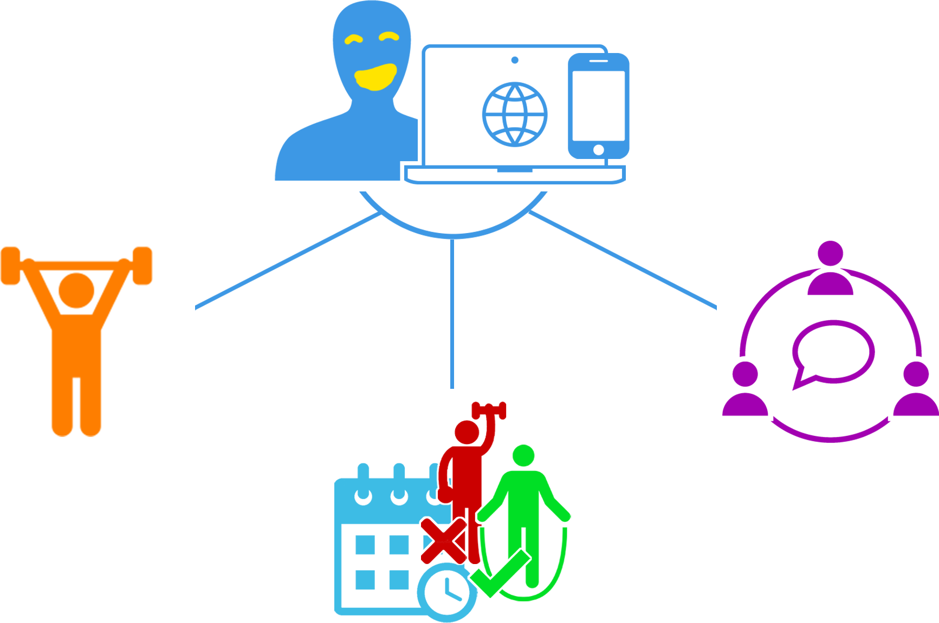
1.3 Problematic
1.0 GENERAL CONTEXT
2020
PFE
Notes:
So the proposed solution was to create a web application that allows its users to receive a specific workout that takes into account various conditins as well as connect users with each other in order for them to stay motivated.

Slide 9
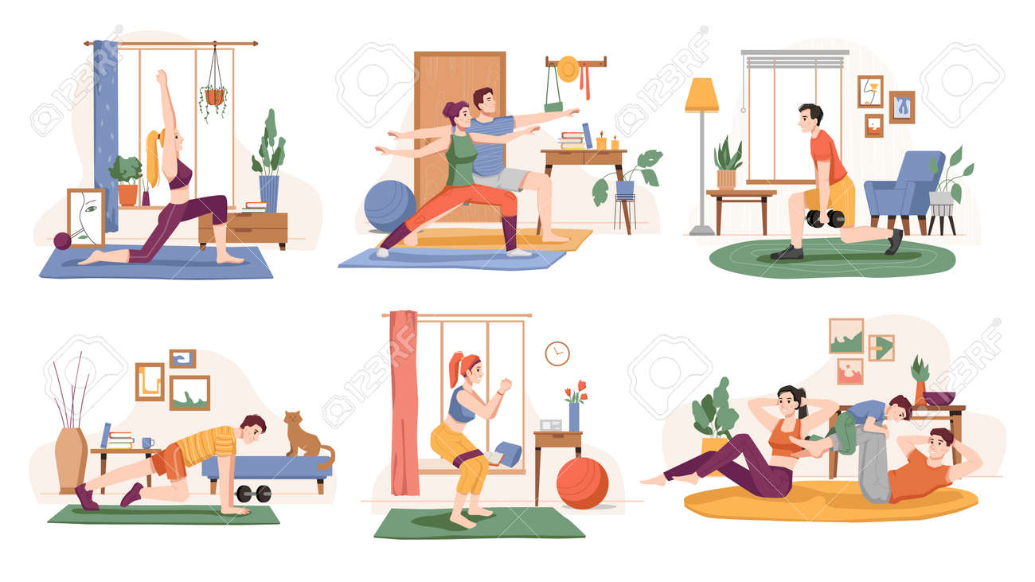
1.0 GENERAL CONTEXT
2020
PFE
Notes:
That way we achieve more

Slide 10
2.0
STUDY OF THE EXISTING AND PROPOSED SOLUTION
Notes:
Now I will move on to the study of the existing and proposed solution

Slide 11
2.0 STUDY OF THE EXISTING AND PROPSED SOLUTION
2.1 Fitness Blender
2.2 Bodybuilding
2.3 SixPackSixWeek
2.4 Proposed Solution
Notes:
After an indepth research, we have found three web applications that respond to our problematic: Fitness Blender, Bodybuilding sixpacksixweek, after we present these application I will present our proposed solution

Slide 12
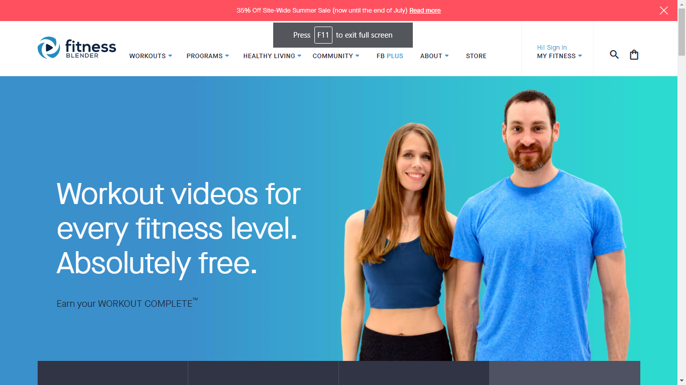
2.1 Fitness Blender
Fitness Blender
Users have to choose the workout plans themselves.
2.0 STUDY OF THE EXISTING AND
PROPOSED SOLUTION
It doesn’t connect users to each other.
2021
PFE
Notes:
Fitness Blender is a fitness platform that offers full-length workout videos, workout programs, and diet and meal plans.

Slide 13
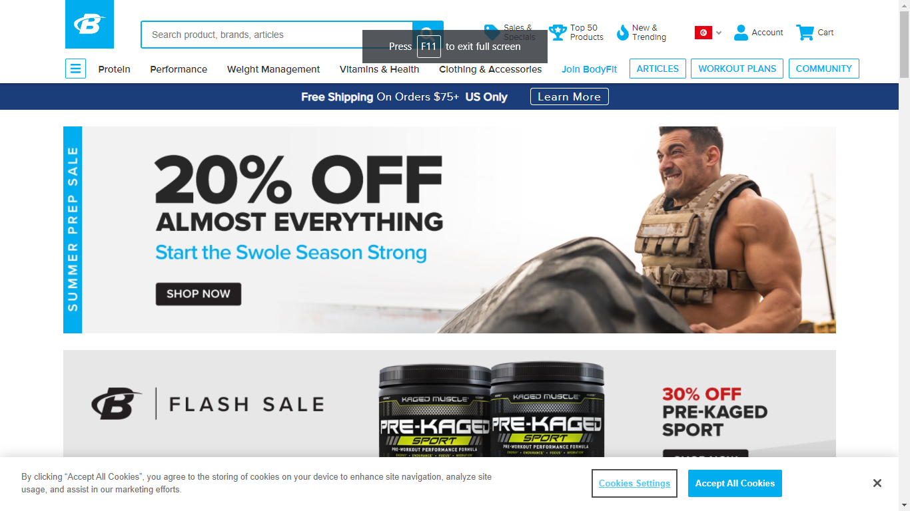
BODYBUILDING
Bodybuilding.com
Mainly a shop
2.0 STUDY OF THE EXISTING AND
PROPOSED SOLUTION
Users have to choose the workouts.
Most of their diets and workouts require users to buy supplements.
2021
PFE
Notes:
Orginaly it was an online retailer of sport supplements, but now it has become a great resource for workout plans created by experts

Slide 14
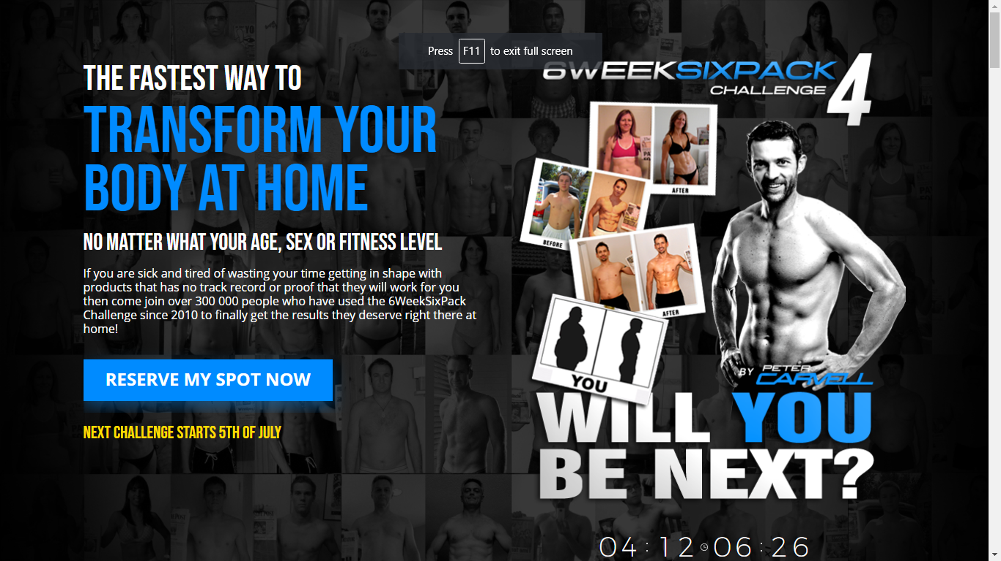
6pack6week
6pack6week
It doesn’t specify workout for
specific users
2.0 STUDY OF THE EXISTING AND
PROPOSED SOLUTION
It doesn’t connect user with each other
2021
PFE
Notes:
6weeksixpack is a website that offers a fitness challenge, it gives daily instruction but it doesn’t specify workout for specific users, and it doesn’t connect users with each other

Slide 15
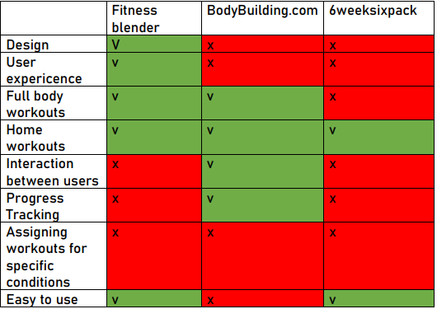
Comparison of Existing solutions
2.0 STUDY OF THE EXISTING AND
PROPOSED SOLUTION
2021
PFE
Notes:
This is the table that contains the comparison of existing applications according to these criteria: Design, user experince, Full body and home workouts, interaction between users etc..

Slide 16
2.3 Proposed solution
To connect with other users to stay motivated.
To create workouts with daily instructions
Our Solution
2.0 STUDY OF THE EXISTING AND
PROPOSED SOLUTION
To manage users and workouts effectively
To receive workout program based on certain condition
2021
PFE
Notes:
Now our proposed solution is a web application that allowed users to :
-receive workout program based on certain conditions
-to connect with other users to stay motivated
-to create workouts ith daily instructions
-to manage users and workouts effectively

Slide 17
Specifications
3.0
Notes:
After finishing the general context,we will move on to specifications…

Slide 18
3.0 Specifications
3.1 System actors
3.2 functional needs
3.3 Non functional requirements
3.4 General use case diagram
Notes:
The specifications will be divided to three parts:
-system actors
-functional needs
-geneal use case diagram

Slide 19


3.1 System actors
3.0 Specifications
User
Administrator
2021
PFE
Notes:
Our system will have two actos:
-the user and the administrator

Slide 20
3.2 Functional needs
User
3.0 Specifcations
Register.
Authenticate.
Consult workout.
Chat with other users.
Create support group.
Manage his goal.
Manage his settings.
Adminstrator
2020
PFE
Notes:
The user will be able to:
Register
Authenticate
Consult workout
Chat with other uses
Create support group
And finaly manage goals and settings

Slide 21

3.2 Functional needs
Manage workouts.
Manage Users .
Utilisateur
3.0 Specifications
Administrateur
2K21
PFE
Notes:
The adminstator will be able to manage workouts and users

Slide 22
3.4Non functional requirements
Modularity
Reusability
3.0 Specifications
Ergonomy
Performance
Security
Scalability
Notes:
Among the non functional requirements we can mention:

Slide 23
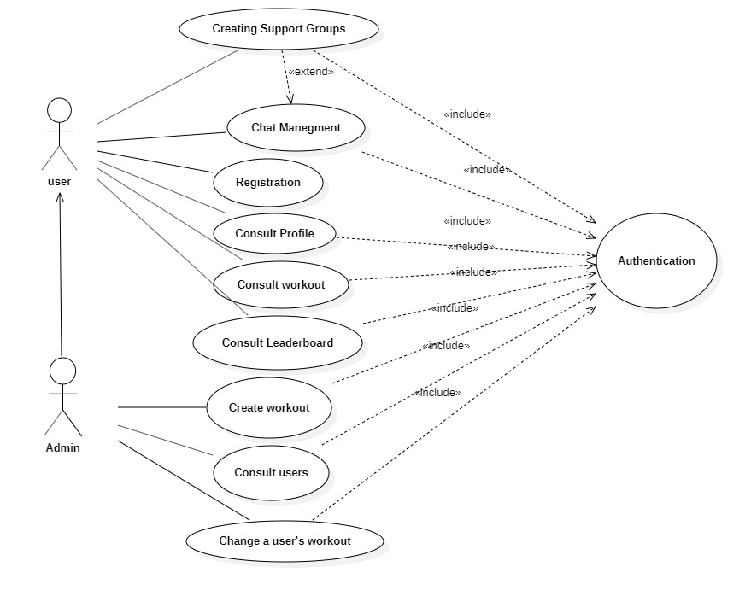
3.3 General use case diagram
3.0 ANALYSE ET SPÉCIFICATIONS DES BESOINS
2021
PFE
Notes:
To better understand the fonctional neds, we presen the general use case diagram

Slide 24
Conception
4.0
Notes:
In the following, we present the conception

Slide 25
4.0 CONCEPTION
4.1 Class Diagram
4.2 Exemple of sequence diagram:Authentication
Notes:
In this section , we will present the Class diagram and the authentication sequence diagram

Slide 26
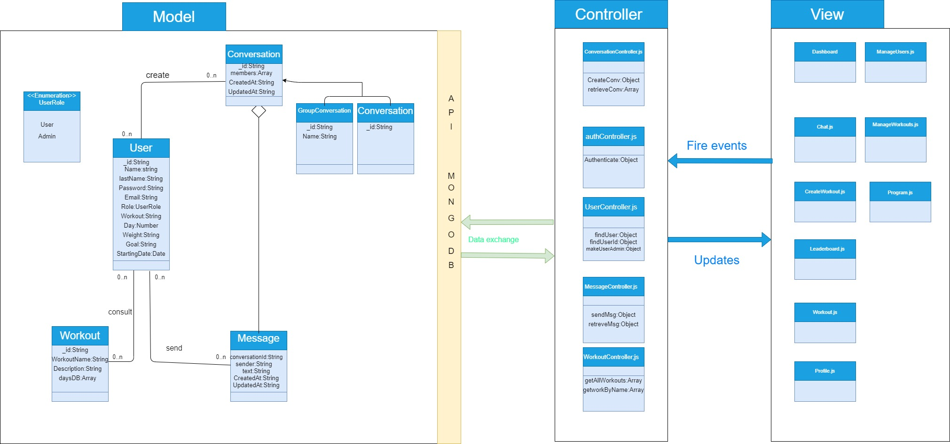
4.1 Classe Diagramme
4.0 Conception
2021
PFE
Notes:
Moving on ,this the class diagram of our application, we have 6 class in the model , 5 in the controller and sevreal views in components

Slide 27
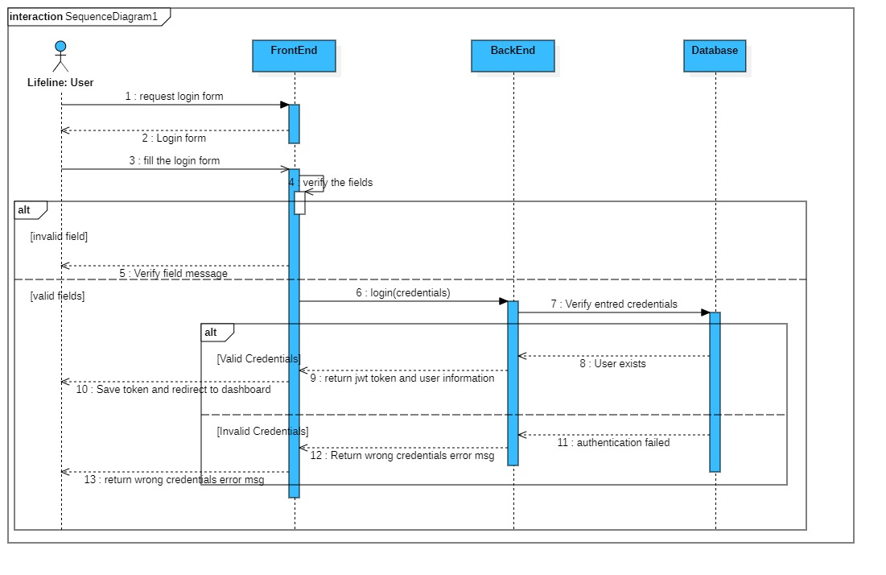
4.2 Authentication Sequence diagram
4.0 Conception
2021
PFE
Notes:
And now we move on to the authenticaion sequence diagram (il fait intergai r les actor user: front…)

Slide 28
Realisation
5.0
Notes:
Moving on to the realisation ,in which will start by presenting the technologies followed by a demonstration of the accomplished work

Slide 29





5.1
React.js
Node.JS+Express.JS
5.0 REALISATION
Technologies
Used
MongoDB
2021
PFE
Notes:
In our project we chose the popular mern stack which is composed of React JS on the frontend, Node.js and express.js on the backend and mongodb for the database

Slide 30



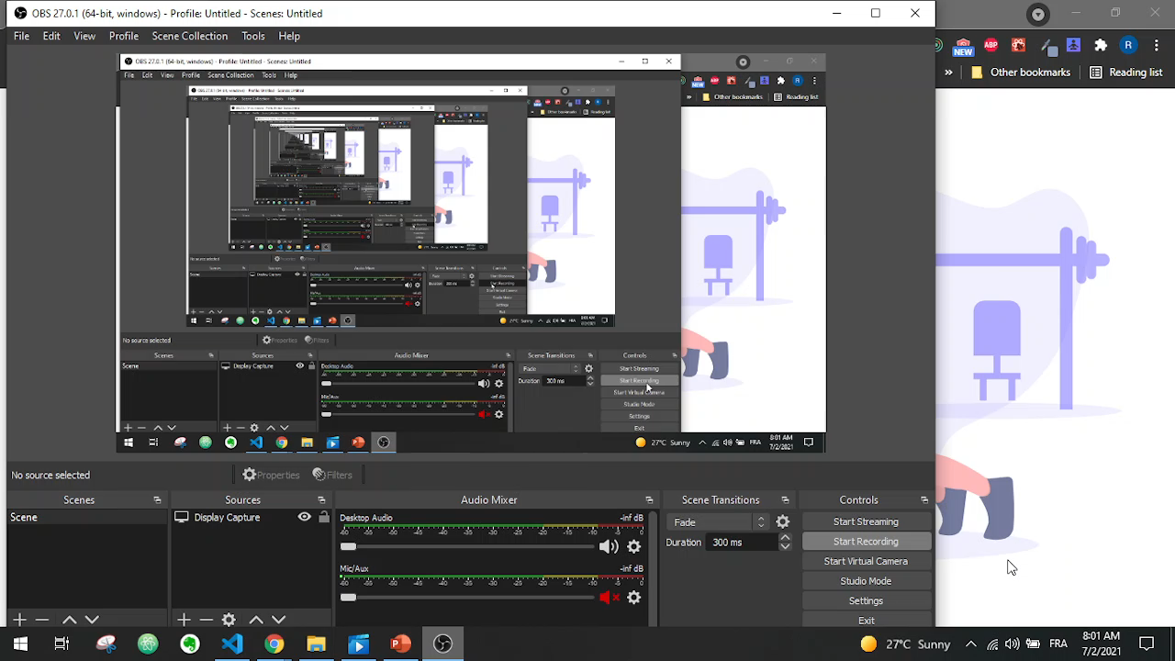


DÉMONSTRATION
DEMONSTRATION
33
Notes:
Moving on to the demonstration

Slide 31
CONCLUSION AND PERSPECTIVES
6.0
Notes:
And now we finish our presentation with the conclusion and perspectives.

Slide 32
6.1 Conclusion
The Planet Fitness application will allow its users to receive a fitness program that :
-Meets their goals
-Takes into consideration multiple factors like user’s age,gender…
-Connect users with each other
Notes:
The planet fitness application will allow its users to receive a fitness program that : meets their goals takes into consideratino multiple factors like users age gender
And connect user with each other as well as allow the admin to easily manage the users and workouts

Slide 33






6.2 Perspectives
Create video chat
Create a forum
Create a home feed
3
2
4
5.0 CONCLUSION ET PERSPECTIVE
1
5
Nutrition guide
Create a mobile appication
7
2021
PFE
Notes:
In case we decided to continue workon on this project, theres more that can be added such a mobile version, a home feed where theres more interaction between users, video chat functionalite, a forum for question and nutrition and diets guides

Slide 34

Notes:
I would like to thank you all for your attention. And feel free to ask any questions

